Slide 1
CS111: Operating Systems Principles
Lab 1A: Simpleton Shell
Vishwas Suryanarayanan

Slide 2
Note
Monday is a holiday (MLK day)
Office hours will be held on Thursday instead (2 hour block)
10:00 AM to 12 PM
BH 3256S
No office hours on Wednesday.

Slide 3
Problem 1A: Make your own shell
Full Description here: https://web.cs.ucla.edu/classes/winter19/cs111/assign/lab1.html
Setup:
Development environment with gcc, glibc, make, gdb
Goal:
Make your own shell
Support creation and opening of files, subprocess creation.
Work with child processes and interprocess communication
Exit with appropriate messages on errors
Submit:
Tar ball with source module, Makefile, README

Slide 4
Review of getopt_long(3)
Function definition:
int getopt_long(int argc, char * const argv[], const char *optstring, const struct option *longopts, int *longindex);
struct option
struct option { const char *name;
int has_arg;
int *flag;
int val;
};
optstring:
Contains a series of characters that correspond to the short options
A colon is placed after a character to indicate that the option that precedes the colon has a argument value passed

Slide 5
Review of open (2)
Function Definiton:
int open(const char *pathname, int flags, mode_t mode);
Flags for open:
O_RDONLY, O_WRONLY, O_RDWR, O_CREAT, O_TRUNC,
O_APPEND, O_CLOEXEC, O_CREAT, O_DIRECTORY
O_DSYNC, O_EXCL, O_NOFOLLOW, O_NOBLOCK, O_RSYNC, O_SYNC
Arguments to support:
--rdonly, --wronly

Slide 6
Questions?

Slide 7
pipe (3)
Function definition in signal.h:
int pipe(int fd[2]);
Used to create a pipe:
A file with no name, and 2 file descriptors: a read-end and a write end
fd[0] : read end
fd[1] : write end
Used for interprocess communication between processes that share some level of parent-child relationship
Used even in bash: echo “Hello world” | grep “Hello”

Slide 8
fork (2)
Used to create a child process
pid_t fork(void);
Returns two values on success! How?
Returns 0 to the child process
Returns a number > 0 to the parent process
PID of the child process
Used in UNIX systems for the creation of any process
Parent can monitor the child process’ resource usage, exit status, etc.

Slide 9
What does the child get?
The open file descriptors
A copy of the code and data segments
A copy of the stack
Resource utilization is set to 0
The parent’s signal mask
But not!
The process id, parent process id
Memory locks, alarms, timers, semaphores, file locks
Pending signals

Slide 10
wait (2)
Used by a parent process to wait on a child process’ execution
pid_t wait(int *status);
Blocking function calls
Returns the PID of the child process that terminated (OR ?)
Status: a pointer to an integer, wherein a status word will be written
Can be inspected with these macros:
WIFEXITED(status)
WEXITSTATUS(status)
WIFSIGNALLED(status)
WTERMSIG(status)
WIFSTOPPED(status)

Slide 11
exec (3) family of commands
Function definitions:
int execl(const char *path, const char *arg, ...); int execlp(const char *file, const char *arg, ...); int execle(const char *path, const char *arg, ..., char * const envp[]); int execv(const char *path, char *const argv[]); int execvp(const char *file, char *const argv[]); int execvpe(const char *file, char *const argv[], char *const envp[]);
But actual system call:
int execve(const char *filename, char *const argv[], char *const envp[]);

Slide 12
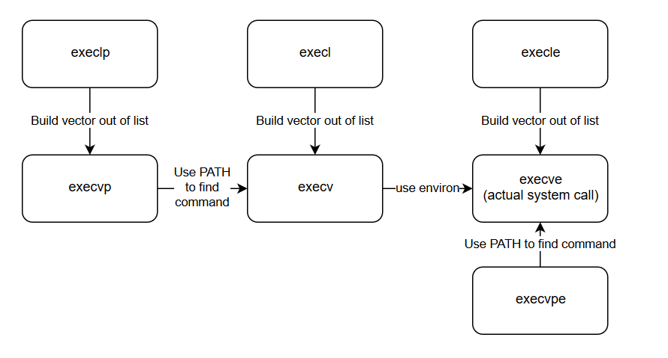
Illustration

Slide 13
Remember!
We have a sanity test script to use again!
Latest version updated on Thursday.
No partners!
Tar-ball must contain:
README with NAME, ID, EMAIL
Source module, and any test scripts
Makefile
While building, don’t forget these flags: g Wall Wextra
Make sure all erroneous input are handled as per the spec

